Slide 1


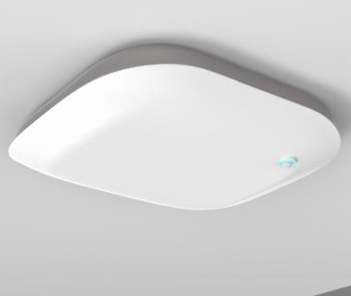

RadioVisionTM
BLE Doorway Chokepoint
99.9% Room Accuracy
Battery Powered Device Mounts Easily to Ceiling inside Doorway
And Detects any BLE Devices Entering and Exiting
How it works:
PIR Motion Detector Turns receiver on when there is motion under the door
Using BLE AoA frames, analyzes the path of travel to recognize an Entry or Exit
Average detection time of 5 seconds
Easy Integration with Existing BLE Location Systems – sends BLE advertisements with Entry/Exit events
Unique and Patented DSP algorithms and ML trained on hundreds of thousands of examples
Works with any BLE 5.1 device that can transmit CTE frames
Enables Key Hospital Use Cases that require 99.9% room accuracy, including:
Nurse Call Cancel, Patient Engagement, Workflow Optimization, PAR Level Stocking, Hand Hygiene Compliance
A Disruptive Solution the industry has been wanting for 20 years!
Legacy room accurate solutions use proprietary tech like IR and US - which is expensive and not future proof
Newer solutions using PoE anchor points to triangulate or trilaterate XY location cannot achieve 99.9% room-accuracy due to multipath and placement errors
BENEFITS
Easily turns any BLE location solution into a 99.9% Room Accurate solution
Standard-based Solution, no proprietary technologies
Mounts Easily and Quickly, with little configuration.
Battery Powered, with no PoE required
FEATURES
4x4 BLE AoA Antenna
PIR Motion Detector
5 Year Lithium Battery
All DSP/ML processing runs locally on Device.
OTA Firmware Update.

Slide 2
RadioVisionTM
BLE Doorway Chokepoint
TECHNICAL SPECIFICATIONS
BLE Radio 1:
Rx-only radio optimized for AoA CTE frame reception
4x4 AoA antenna Array
BLE Radio 2:
Rx/Tx Radio with Full BLE stack for gateway communications and other BLE functions
Omni antenna
Supports up to 10 dBm output power with coded PHY for long range to gateway
CPU
All DSP and ML processing performed in the device
Vector Accelerator for fast real-time processing
Scaling
Up to 50 Tags processed simultaneously
Compatibility
Works with any BLE 5.1 device that can transmit CTE frames
Certifications:
FCC, Canada, ETSI
UL and CE
Batteries
2 D-Cell Lithium
5 years battery life based on 20 crossings per hour
Optional PoE power (802.3af) for extremely busy doorways
Physical
Dimensions: 8” x 8” x 1”
Operating Temperature: 32 to 122 °F / 0 to 55°C
Dual-zone curtain PIR: Detects doorway motion
Installation
Easy to install - mounts inside doorway to the ceiling grid.
Minimal configuration required.
Supports OTA Firmware Update
Emanate Wireless, Inc
675 Alpha Drive, Suite G
Highland Heights, OH 44143
844-EMANATE
info@emanatewireless.com

